Slide 1
Repeat Buyers Prediction
CECS 550 : Pattern Recognition
Spring 2023
Group :- 7
Anthony Martinez
Diksha Patil
Pratik Jadhav
Pavan More
Sudarshan Powar
Instructor: Prof Mahshid Fardadi
Teaching Assistant: Rahul Deo Vishwakarma

Slide 2
Agenda
Background and Goal
Datasets Interpretation
Feature Engineering
Dataset statistics and feature ranking
Prediction model
Model evaluation
Results
Conclusion
Notes:
Short Summary of every topic

Slide 3
Background and Goals
1. A shop runs big promotions on “Double 11” - the biggest online shopping event, in order to attract a large number of new buyers.
2. Unfortunately, many of the attracted buyers are one-time deal hunters, and these promotions may barely a have long-lasting impact on sales.
3. To reduce the promotion cost and enhance the return on investment (ROI), they want to identify who can be converted into repeated buyers.
Goal
1. Predict the probability of the given user becoming a repeat buyer of the given merchant in the future
2. To find the most important factor to predict repeat buyers
Notes:
General vs Narrow — nlp, vision on a particular task
Use of transformers

Slide 4
Data Interpretation
The data set contains anonymized user’s shopping logs in the past 6 months before and on the “Double 11” day.
The dataset has -
User profile :-
age_range , Gender , User_id
User Behavior Logs :-
user_id, item_id, cat_id, merchant_id, brand_id, time_stamp, action_type

Slide 5
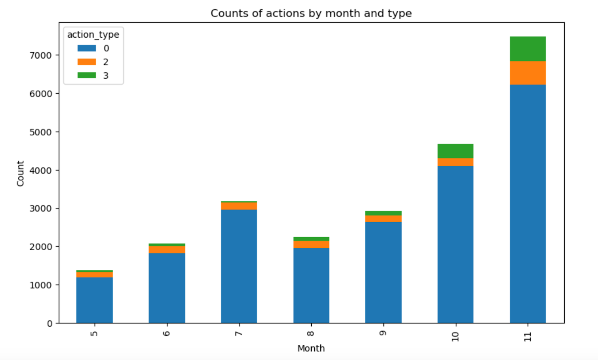
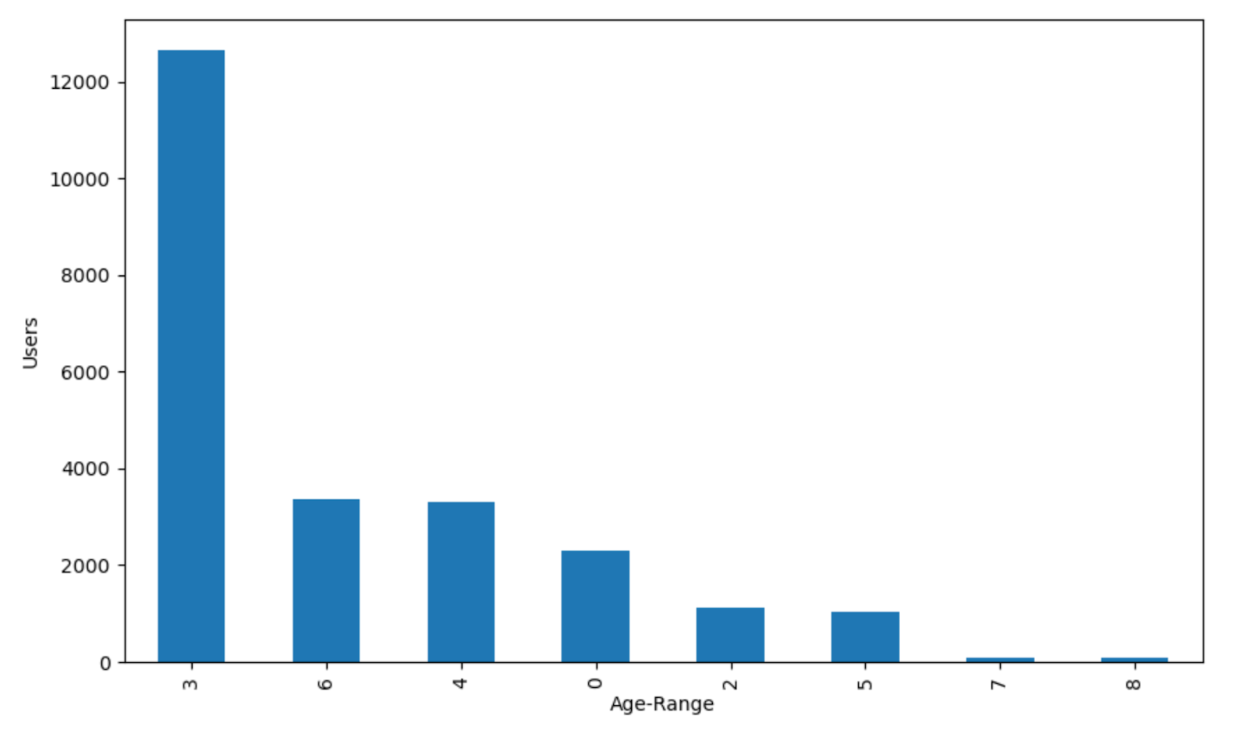
Data Visualization
Figure 1: Users from different age-range Figure 2: Counts of actions by month and type

Slide 6
Feature Engineering
1. Average User Age for each Category
2. Purchase Average Time
3. Purchase Ratio
4. Purchase Frequency
5. Average User Age for each Merchant
6. Ratio of add-to-cart actions to clicks for each Merchant
7. Number of distinct brands a user has interacted with for each Merchant
8. Number of distinct categories a user has interacted with for each Merchant
Notes:
Data is made homogenous

Slide 7
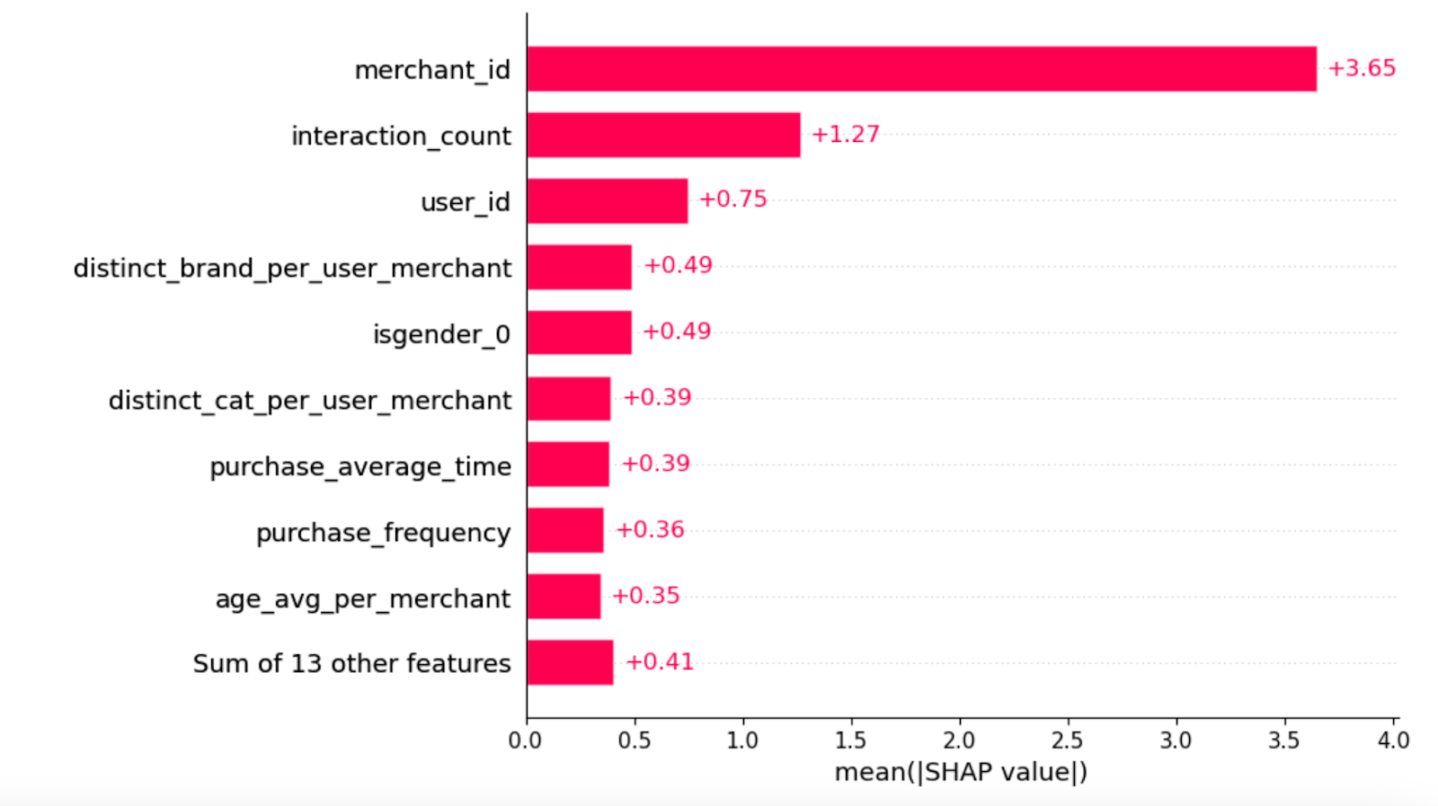
Feature Ranking
Figure 3: Important features based on SHAP

Slide 8
Model Predictivity Split Data
Randomly split data into
Training set : 80%, for model training.
Testing set : 20%, for model testing.
First, we use the original data to train baseline models with 3 different algorithms
Random Forest
XGBoost
Neural Networks
Bayes classifier
KNN

Slide 9
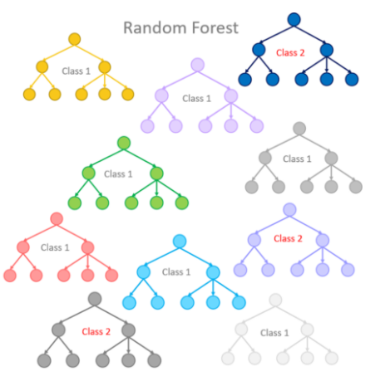
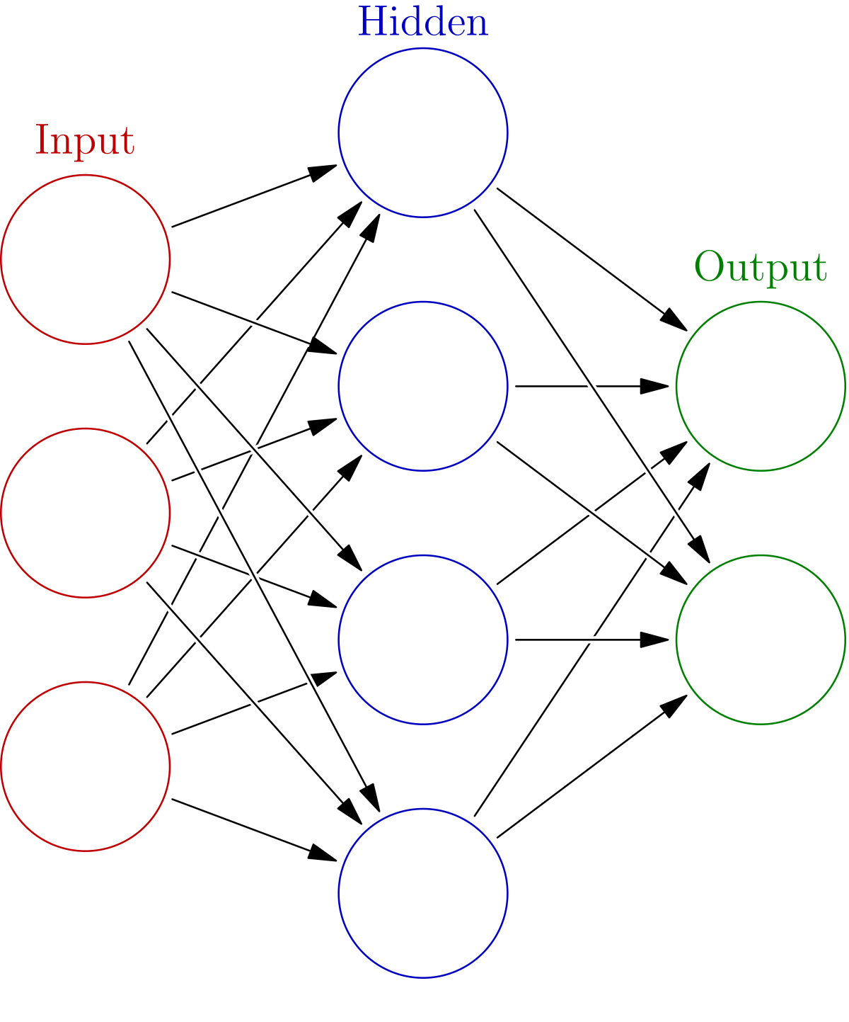
Random forest:
Different classifiers overfit the data in a different way,
and through voting those differences are averaged out.
Neural Network
They consist of interconnected nodes or neurons that process and transmit
information to make a prediction or decision. A neural network typically
Consists of multiple layers, including an input layer, one or more hidden layers,
and an output layer.
Notes:
the first three captions sampled using temperature 0.9, without cherry-picking
Usually Gato replies with a relevant response, but is often superficial or factually incorrect, which could likely be improved with further scaling.

Slide 10
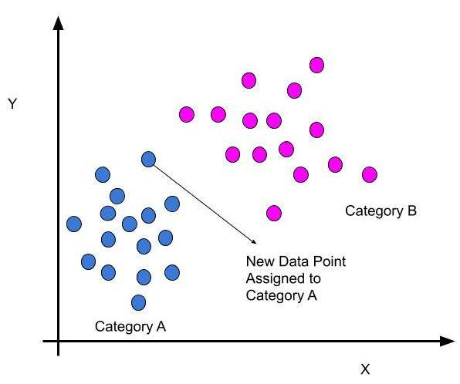
Bayes classifier:
Bayes' theorem is a fundamental principle in probability theory that describes the probability of an event based on prior knowledge or information.
KNN:
It is a non-parametric algorithm that makes predictions based on the k nearest neighbors of a new data point in the training data.
Notes:
the first three captions sampled using temperature 0.9, without cherry-picking
Usually Gato replies with a relevant response, but is often superficial or factually incorrect, which could likely be improved with further scaling.

Slide 11
Performance on unseen tasks
Notes:
Positive transfer
Negative Transfer for atari boxing
The model performed better in 3 settings even if all data with other tasks was used for training it.
This could mean with more data it would be even better and also better for few shot learning

